Slide 1

ASSIGNMENT GUIDELINES
Make the changes in the PPT as you solve the parts
This file contains the template for all the parts of the project.
Check the instructions added in the note section of every slide for clarity.
Don’t move around any image or text box
If you require more/lesser elements, be careful when you copy/delete the existing ones.

Slide 2
ASSIGNMENT Name: …T. Arun Nellaiappan………..
Problem Statement The sales pipeline conversion percentage at TechnoServe (a tech SaaS startup) has dropped from 35% at the end of last fiscal (FY 2017-18) to 25% at present.
Assignment Objective
Understand the problem, come up with a hypothesis for low conversions faced by TechnoServe, and analyse the dataset provided to arrive at possible solutions to increase it.
Notes:
Problem Statement

Slide 3
PART I : 1. Understanding the Problem Sales Pipeline Conversion at a SaaS Startup
Who?
Technoserve (a Saas startup) is facing the problem
What?
The sales pipeline conversion percentage at TechnoServe (a tech SaaS startup) has dropped from 35% to 25%
When?
Problem happened in this present FY.
Where?
Where (location/region/city) does the problem mostly happen?
How?
Tele Sales / Marketing channel related issues
Product expectation and quality related issues

Slide 4
PART I : 2. Understanding the Problem Sales Pipeline Conversion at a SaaS Startup
Situation
What are the different stages in sales pipeline process
Problem
Does the sales pipeline conversion process work effectively?
Are your customers happy with features of your product?
Does your pre sales teams engage the customers properly?
Implication
What is the loss of revenue due to this declining conversions?
Does this issue ever prevent your startup to achieve targets?
Need-Payoff
Do you think solving the problem significantly impact on your profit?
Notes:
Provide at least three questions under each branch.

Slide 5
PART II : Formulating Hypotheses Sales Pipeline Conversion at a SaaS Startup
Framework Used
Issue tree framework
Reason for using the selected framework
To cover all the stages of the conversion pipeline, I have selected the issue tree framework
How you have used the framework here
I used Coggle to create the framework
Notes:
All the frameworks that are used should be mentioned.
A suitable reason is a must to provide here

Slide 6
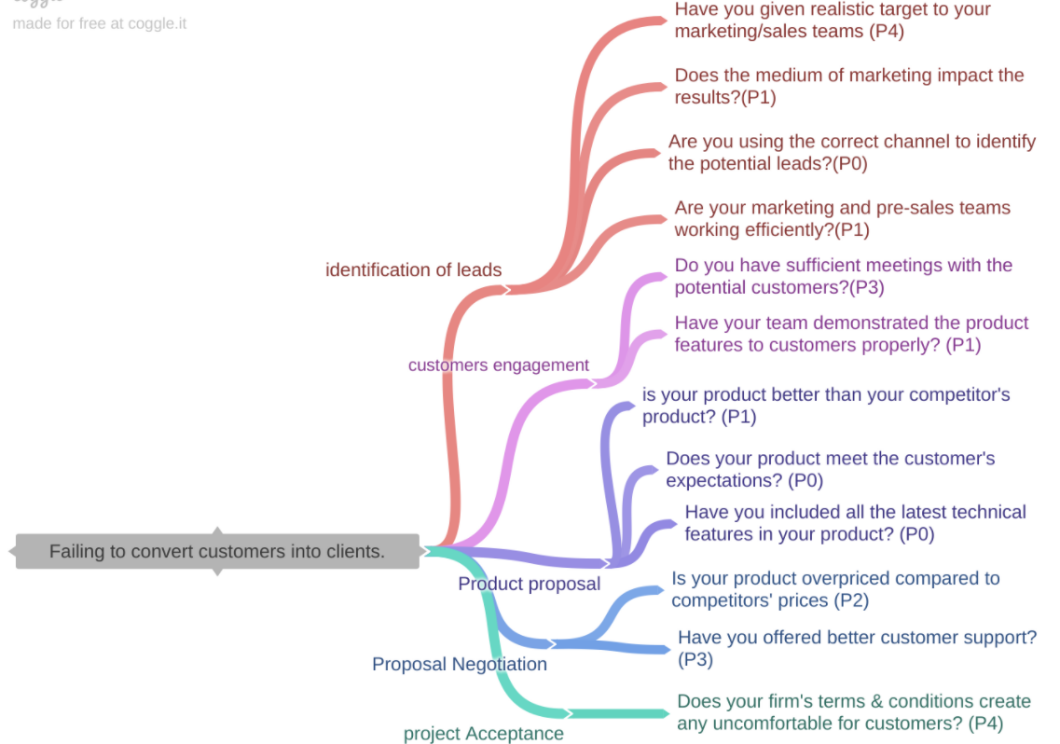
PART II : Formulating Hypotheses Sales Pipeline Conversion at a SaaS Startup
Provide the structure of the framework here
(You can attach the screenshot or multiple screenshots depending on the clarity of the image)
Notes:
Use the “download as” feature of Coggle if you are using the tool.
Provide one image with complete tree along with separate elements where the text is readable.
Copy the slide if you require more space

Slide 7
PART II : Formulating Hypotheses Sales Pipeline Conversion at a SaaS Startup
Branch 1
Does the medium of marketing impact the results?(P1)
Branch 2
Are you using the correct channel to identify the potential leads?(P0)
Notes:
Each branch must follow this naming pattern: Problem – Branch 1 – Sub-branch 1 – Sub-branch 2 – …… – Hypotheses
There must be minimum 10 hypotheses in total and at least 1 in each branch.

Slide 8
PART II : Formulating Hypotheses Sales Pipeline Conversion at a SaaS Startup
Branch 3
Are your marketing and pre-sales teams working efficiently?(P1)
Branch 4
Do you have sufficient meetings with the potential customers?(P3)
Notes:
Each branch must follow this naming pattern: Problem – Branch 1 – Sub-branch 1 – Sub-branch 2 – …… – Hypotheses
There must be minimum 10 hypotheses in total and at least 1 in each branch.

Slide 9
PART II : Formulating Hypotheses Sales Pipeline Conversion at a SaaS Startup
Branch 5
Have your team demonstrated the product features to customers properly? (P1)
Branch 6
is your product better than your competitor's product? (P1)
Notes:
Each branch must follow this naming pattern: Problem – Branch 1 – Sub-branch 1 – Sub-branch 2 – …… – Hypotheses
There must be minimum 10 hypotheses in total and at least 1 in each branch.

Slide 10
PART II : Formulating Hypotheses Sales Pipeline Conversion at a SaaS Startup
Branch 7
Does your product meet the customer's expectations? (P0)
Branch 8
Have you included all the latest technical features in your product? (P0)
Notes:
Each branch must follow this naming pattern: Problem – Branch 1 – Sub-branch 1 – Sub-branch 2 – …… – Hypotheses
There must be minimum 10 hypotheses in total and at least 1 in each branch.

Slide 11
PART II : Formulating Hypotheses Sales Pipeline Conversion at a SaaS Startup
Branch 9
Is your product overpriced compared to competitors' prices (P2)
Have you offered better customer support? (P3)
Branch 10
Does your firm's terms & conditions create any uncomfortable for customers? (P4)
Notes:
Each branch must follow this naming pattern: Problem – Branch 1 – Sub-branch 1 – Sub-branch 2 – …… – Hypotheses
There must be minimum 10 hypotheses in total and at least 1 in each branch.

Slide 12
PART III A : Generating Insights Sales Pipeline Conversion at a SaaS Startup
Variable
Opportunity status
Insights if any
Type your answer here
Out of 78026 leads, only 17627 leads convert into clients.
Pattern of Insight
Type your answer here
Notes:
Analyse the variables in the dataset, find the insights and mention the pattern of insights in the data. Make more copies of this slide if needed.

Slide 13
PART III A : Generating Insights Sales Pipeline Conversion at a SaaS Startup
Variable under consideration: Technology Primary
-99% of customers approach the TechnoServe for ERP implementation and technical business solution
- Though less percentage of customers approach for Analytics, the rate of conversion is more.
Notes:
For each variable that produced an interesting insight, explain you analysis bit here – the results you got from excel and the necessary visualisations. Note: it is compulsory for you to mention the results of the analysis on these variables - 'Technology Primary', 'B2B Sales Medium', 'Client Revenue Sizing', 'Opportunity Sizing' and 'Business from Client last year’.

Slide 14
PART III A : Generating Insights Sales Pipeline Conversion at a SaaS Startup
Variable under consideration: 'B2B Sales Medium
Online Marketing shows very poor results. It reaches very less number of customers and the success rate also less
Notes:
For each variable that produced an interesting insight, explain you analysis bit here – the results you got from excel and the necessary visualisations. Note: it is compulsory for you to mention the results of the analysis on these variables - 'Technology Primary', 'B2B Sales Medium', 'Client Revenue Sizing', 'Opportunity Sizing' and 'Business from Client last year’.

Slide 15
PART III A : Generating Insights Sales Pipeline Conversion at a SaaS Startup
Variable under consideration: 'Client Revenue Sizing
More than 75% of TechnoServe’s customers have revenue sizing less than 100k
Notes:
For each variable that produced an interesting insight, explain you analysis bit here – the results you got from excel and the necessary visualisations. Note: it is compulsory for you to mention the results of the analysis on these variables - 'Technology Primary', 'B2B Sales Medium', 'Client Revenue Sizing', 'Opportunity Sizing' and 'Business from Client last year’.

Slide 16
PART III A : Generating Insights Sales Pipeline Conversion at a SaaS Startup
Variable under consideration: Opportunity Sizing
The opportunity sizing 40K-50K shows very high failure rate (88%), that indicates only 12% successful conversion.
Notes:
For each variable that produced an interesting insight, explain you analysis bit here – the results you got from excel and the necessary visualisations. Note: it is compulsory for you to mention the results of the analysis on these variables - 'Technology Primary', 'B2B Sales Medium', 'Client Revenue Sizing', 'Opportunity Sizing' and 'Business from Client last year’.

Slide 17
PART III A : Generating Insights Sales Pipeline Conversion at a SaaS Startup
Variable under consideration: 'Business from Client last year
Type your answer here
89% of the customers approach TechnoServe are new customers, it implies that old clients are not willing to do business with TechnoServe.
Notes:
For each variable that produced an interesting insight, explain you analysis bit here – the results you got from excel and the necessary visualisations. Note: it is compulsory for you to mention the results of the analysis on these variables - 'Technology Primary', 'B2B Sales Medium', 'Client Revenue Sizing', 'Opportunity Sizing' and 'Business from Client last year’. Make more copies of this slide if needed.

Slide 18
PART III A : Generating Insights Sales Pipeline Conversion at a SaaS Startup
Recommendations
1. New and attractive features have built in ERP implementation and technical business solution products
2. Social media campaign to be conducted for showing the new features to customers
3. Get a feed back from last year client and product to be modified as per their suggestions.
4. Target the opportunity sizing 40K-50K customers with the new features
Corresponding Insights
99% of TechnoServe customers are for implementation and technical business solution products
Number of leads through online is very less and rate of conversion also poor
Not retained the old clients
Rate of successful conversion is very poor for opportunity sizing 40K-50K
Notes:
For each recommendation explain the insights that form the reasoning for giving that recommendation. Make more copies of this slide if necessary.

Slide 19
PART III B : Presenting Findings Sales Pipeline Conversion at a SaaS Startup
New and attractive features have built in ERP implementation and technical business solution products
Social media campaign to be conducted for showing the new features to customers
Retain the last year clients
Target 40K-50K opportunity sizing customers
Notes:
You are free to use the elements and boxes mentioned previously. Make sure you’re using the pyramid principle, data visualization, visual design principle and storyboarding concepts to design these slides.

Slide 20
PART III B : Presenting Findings Sales Pipeline Conversion at a SaaS Startup
Notes:
You are free to use the elements and boxes mentioned previously. Make sure you’re using the pyramid principle, data visualization, visual design principle and storyboarding concepts to design these slides.

Slide 21
PART III B : Presenting Findings Sales Pipeline Conversion at a SaaS Startup
Notes:
You are free to use the elements and boxes mentioned previously. Make sure you’re using the pyramid principle, data visualization, visual design principle and storyboarding concepts to design these slides.

